Slide 1
PID and Lead-Lag Control for Magnetic Levitation System
Lauren Adachi
ENGN 1931Y

Slide 2
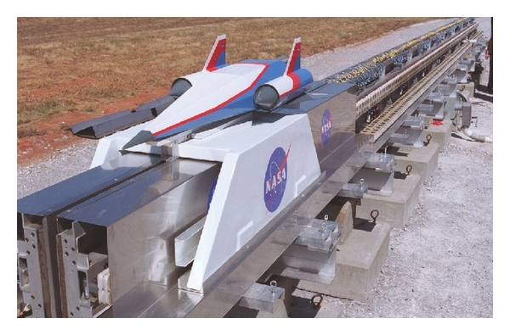
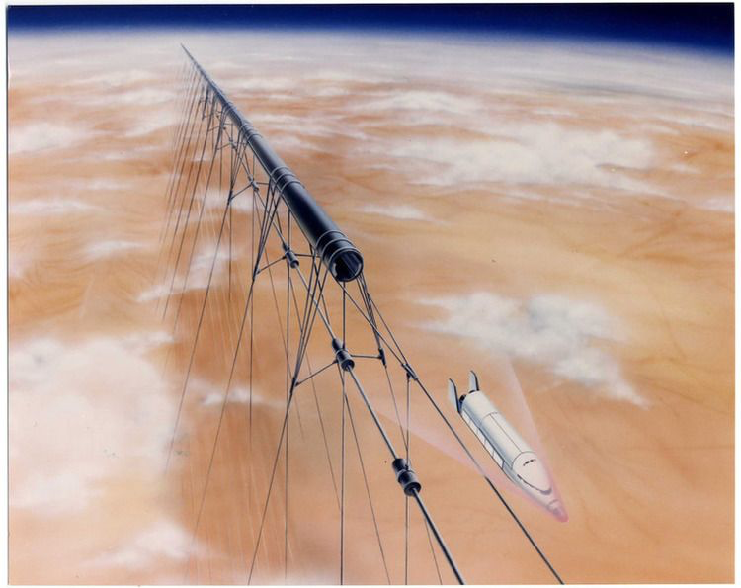
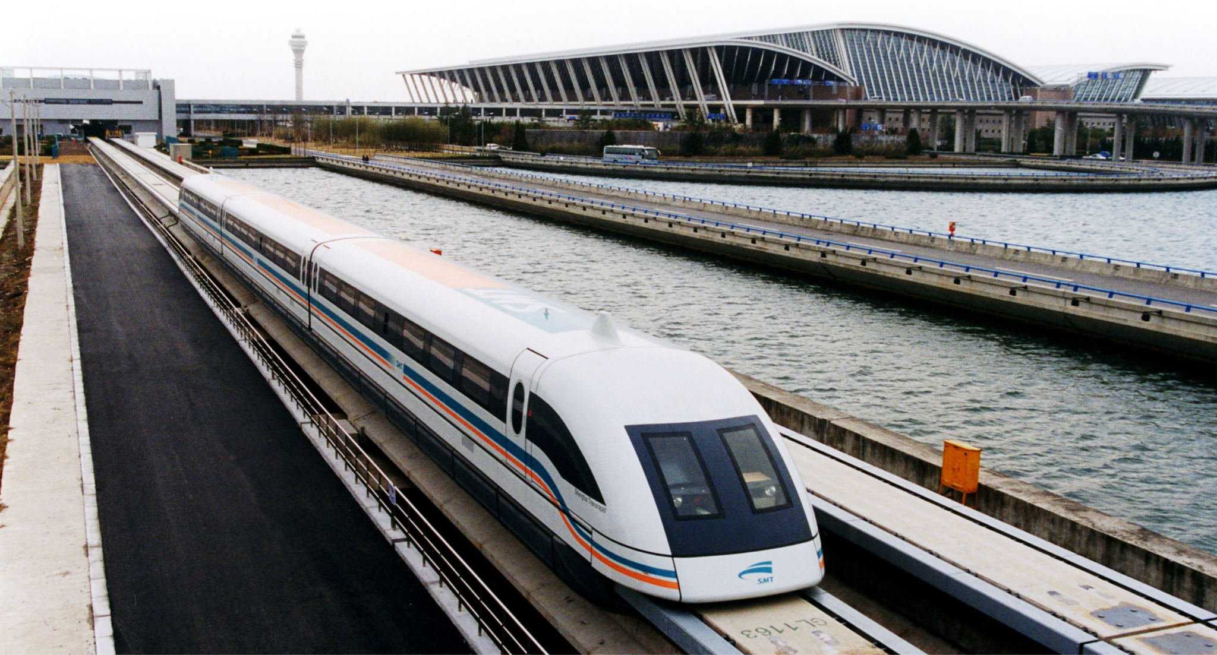
Magnetic Levitation Systems
Motivation: controlling magnetic levitation systems
Applications include
High-speed rail
Spacecraft launches
Manufacturing
Biosensors, diagnostic, tissue engineering
Maglev Train
https://www.hindawi.com/journals/je/2013/537986/
https://www.intechopen.com/books/magnetic-materials-and-magnetic-levitation/magnetic-levitation-based-applications-in-bioscience
https://en.wikipedia.org/wiki/List_of_maglev_train_proposals
https://www.space.com/38384-could-startram-revolutionize-space-travel.html

Slide 3
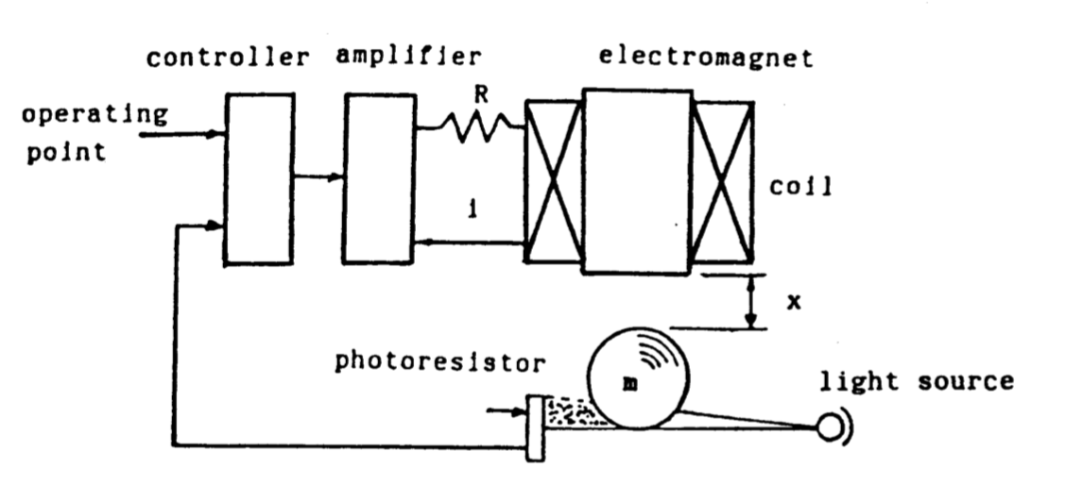
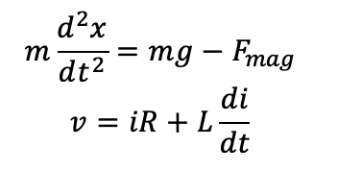
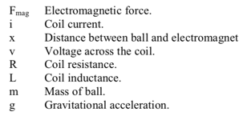
System: Simple Levitation of a Ball
Equations of Motion
Transfer function
https://ieeexplore.ieee.org/document/5570565/
https://ieeexplore.ieee.org/document/8279085

Slide 4
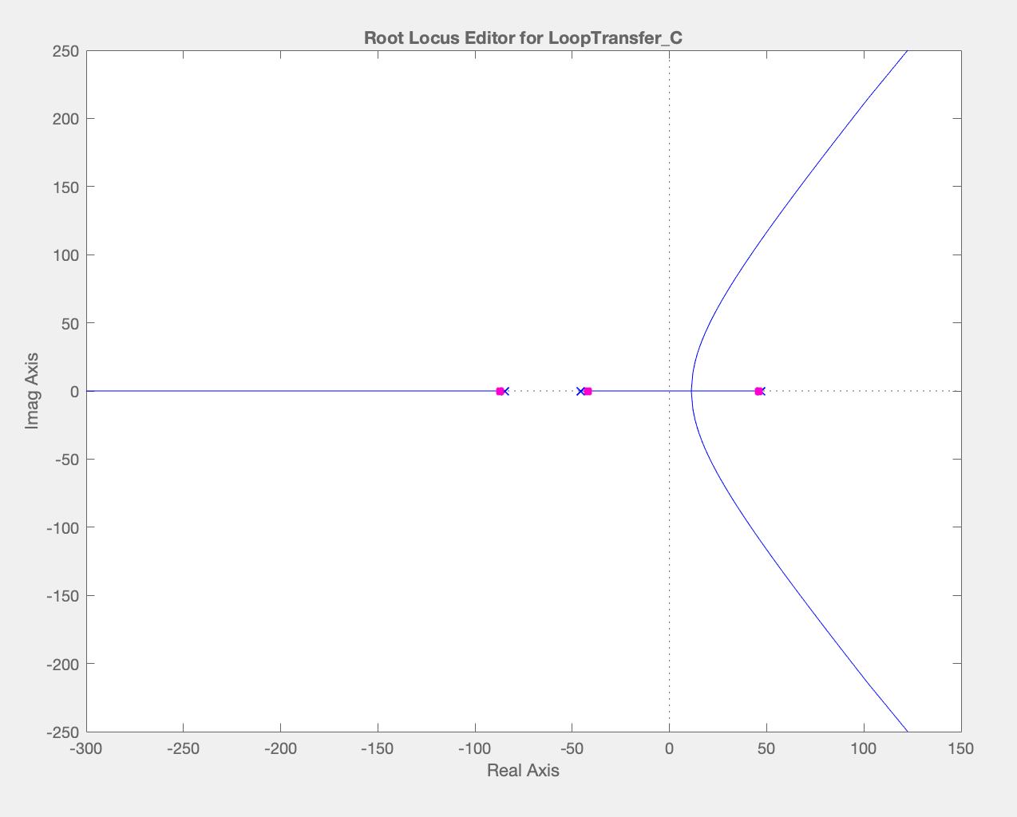
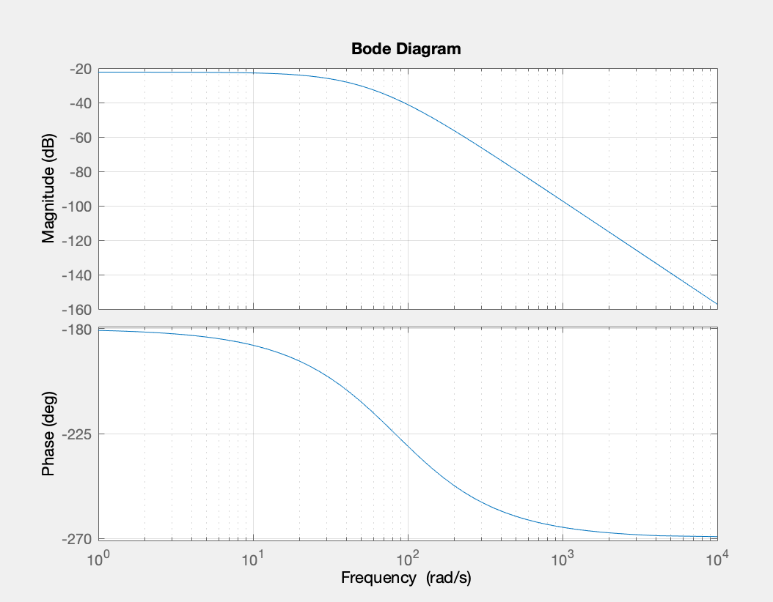
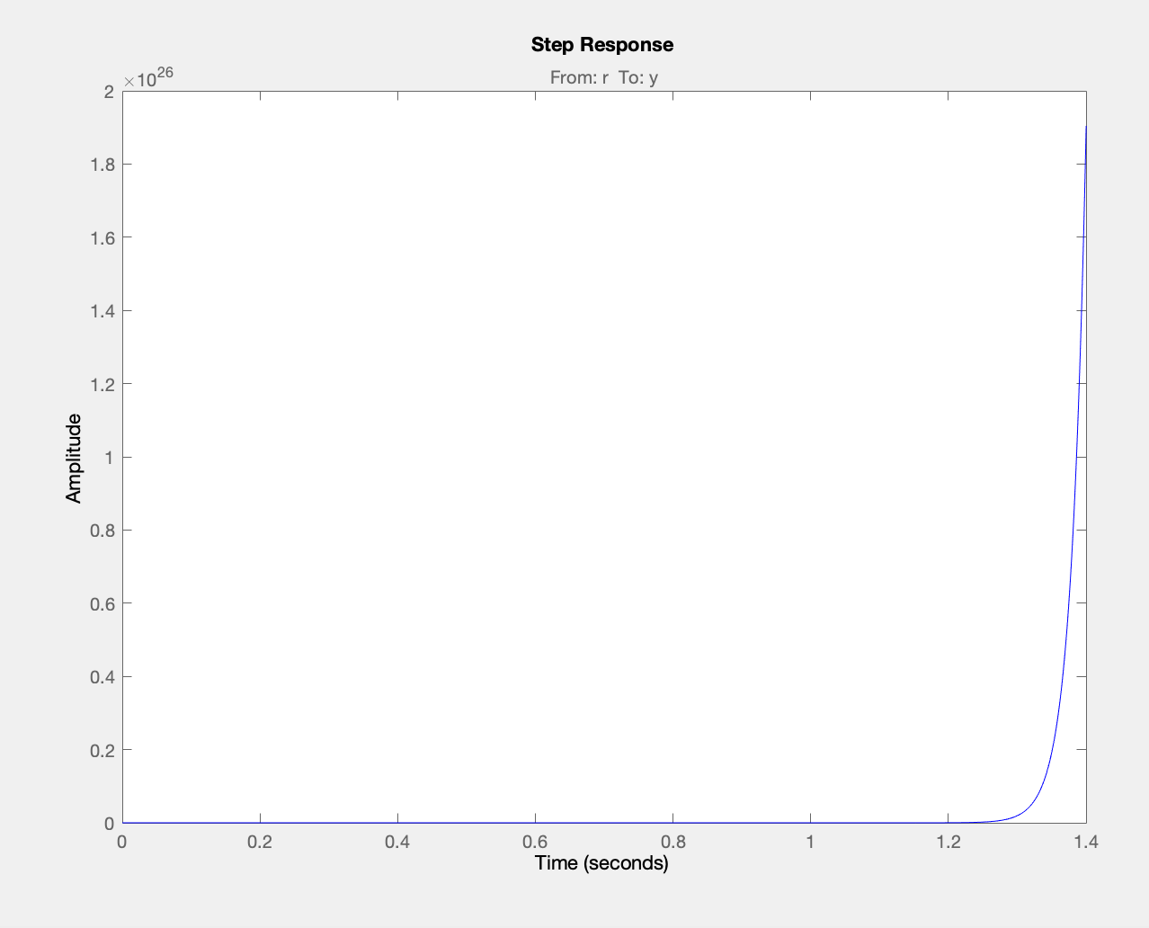
Open-Loop System characteristics
Bode Plot
Phase always less than -180 → positive feedback → unstable
Root Locus
Poles on LHS → unstable
Step Response
Unstable

Slide 5
Frequency Compensator Design

Slide 6
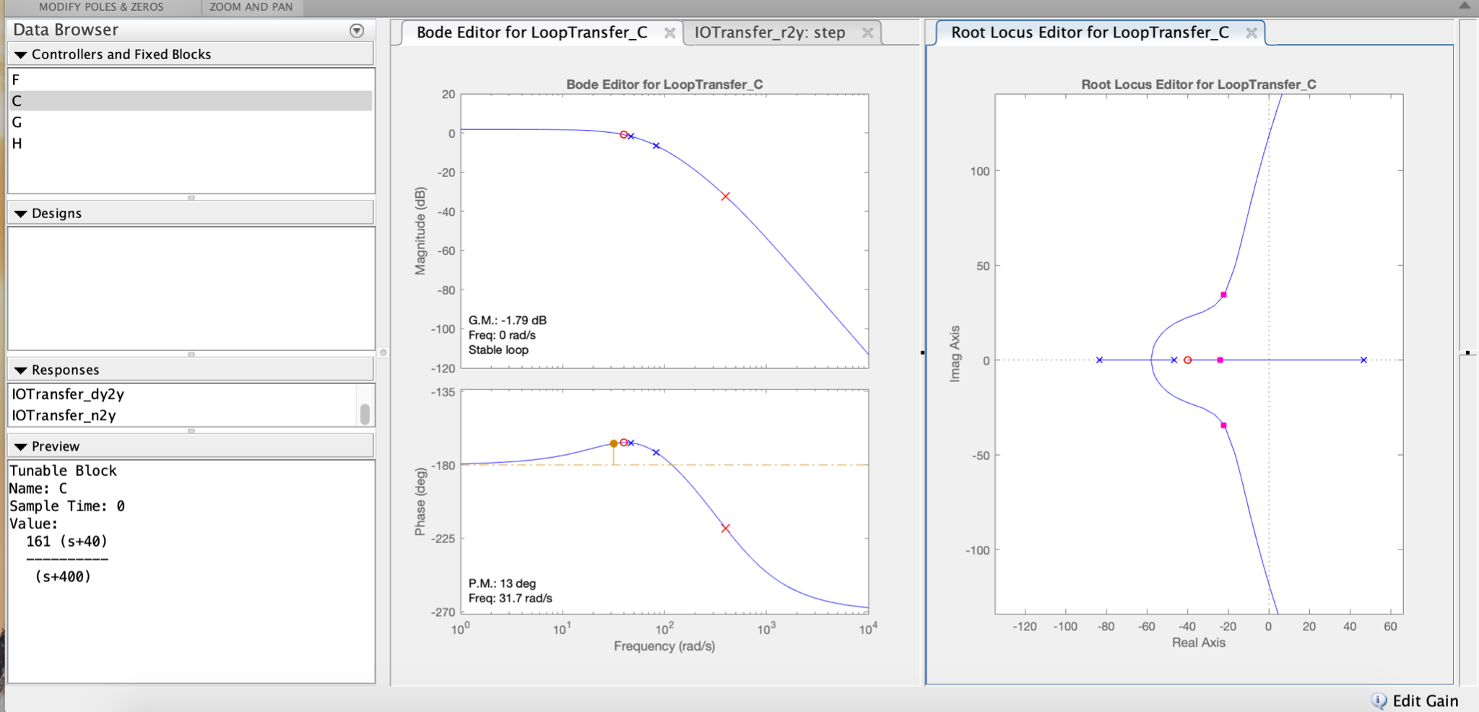
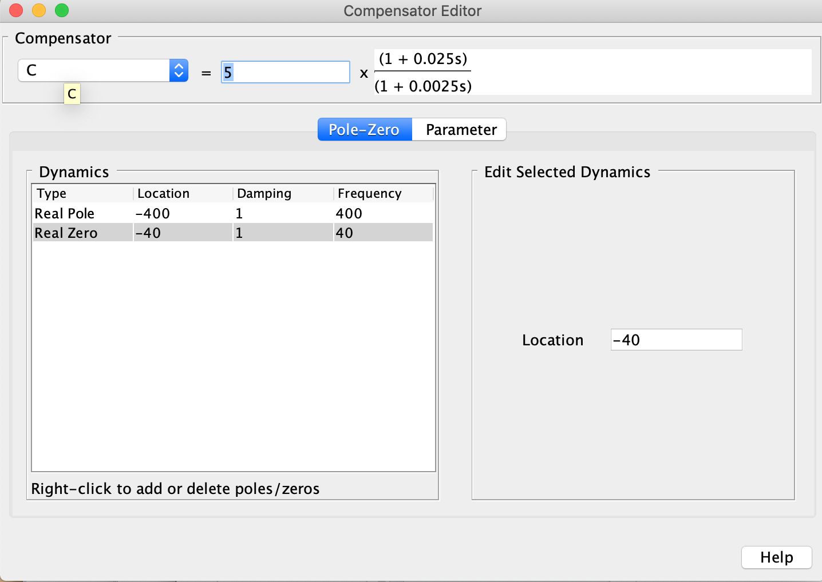
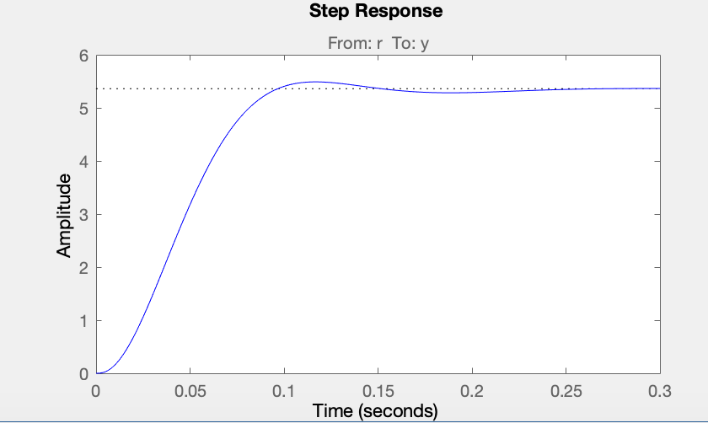
Single Lead: Design
Dc(s) =
Specifications
Time
Fast settling time (0.127s)
Low percent overshoot (2.38%)
Fast rise time (0.0592s)
High steady state error (final value is 5.36)
Frequency
Low GM (1.79 dB)
Low PM (13 dB)
Crossover frequency = 31.7 rad/s
Implementation
Compatible with actuator with +/- 75V range (not common, but does exist)
Requires feasible gain (161 V/V)

Slide 7
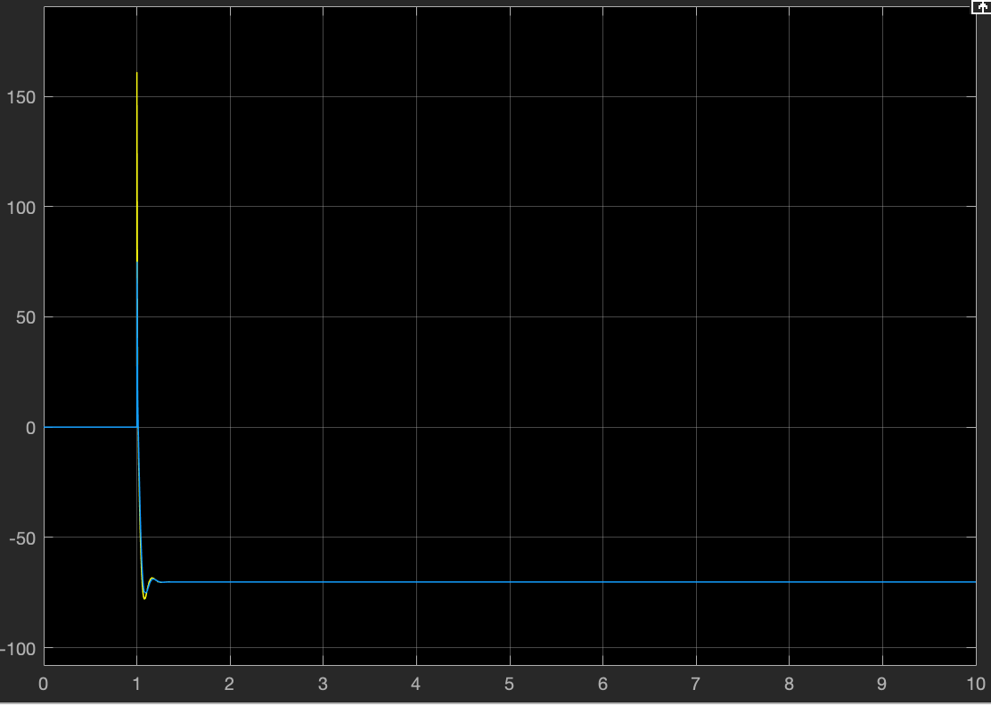
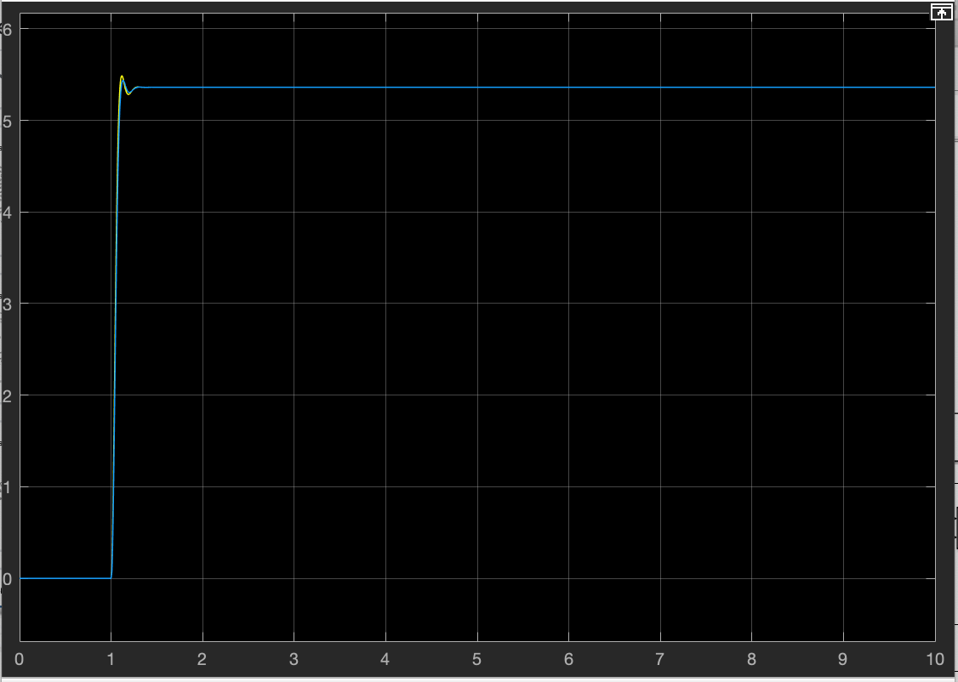
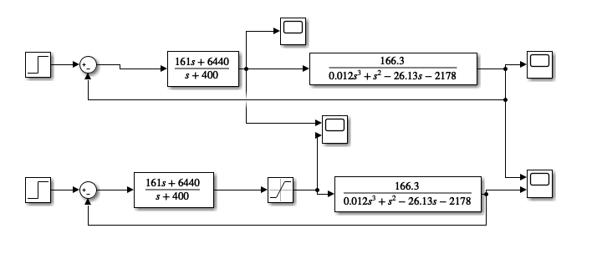
Single Lead: Results
Controller output
Without actuator saturation
Dc(s) =
Compatible with actuator with +/- 75V range
With actuator saturation
System output
Without actuator saturation
Simulink Simulation
Without actuator saturation
With actuator saturation
With actuator saturation

Slide 8
Dual Lead: Design
Dc(s) =
Step 1: Add 2 zeros
System unstable: System TF decreases phase from -180 to -270 degrees
Added zero at low frequencies to make phase go from -90 to -180 degrees
PM to small
Added zero at location of w_crossover to increase phase (far above -180) at w_crossover, increasing phase margin significantly
Pros
Stable
Fast rise and settling time
No SS error
Large GM and PM
Cons
Derivative control very sensitive to noise IRL
Required gain very large
Next: Add poles

Slide 9
Dual Lead: Design
Dc(s) =
Step 2: Adding Poles
Added 2 poles to make system less sensitive to noise
Added these poles at very high frequencies to cancel out the effect of both zeroes at high frequencies, while preserving the behavior designed at frequencies of interest
Cons
Required gain very large
Next: reducing gain

Slide 10
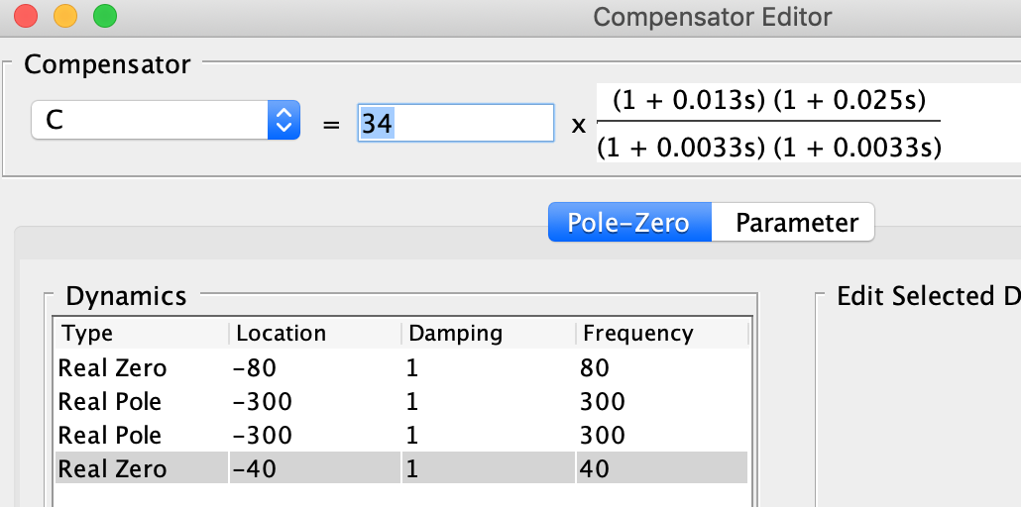
Dual Lead: Design
Step 3: Reducing gain
Need to decrease gain because of actuator saturation
Challenging to keep gain below 1000 while keeping the phase at |G| = 1 greater than 30 degrees
Dc(s) =
Specifications
Time
Fast settling time (0.0.064s)
Higher percent overshoot (14.3%)
Fast rise time (0.0121s)
Lower steady state error (final value is 1.63)
Frequency
Good GM (8.3 dB)
Good PM (30 degrees)
Crossover frequency = 115 rad/s
Implementation
Compatible with actuator with +/- 25V range
Requires feasible gain (161 V/V)

Slide 11
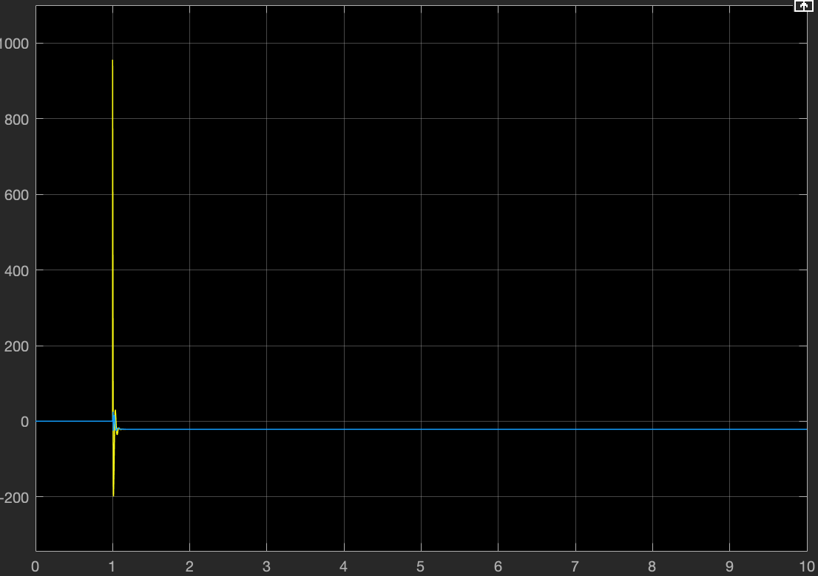
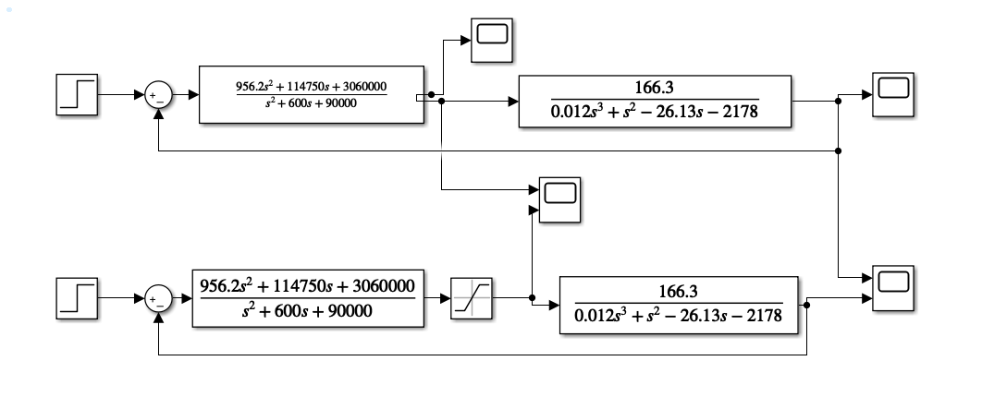
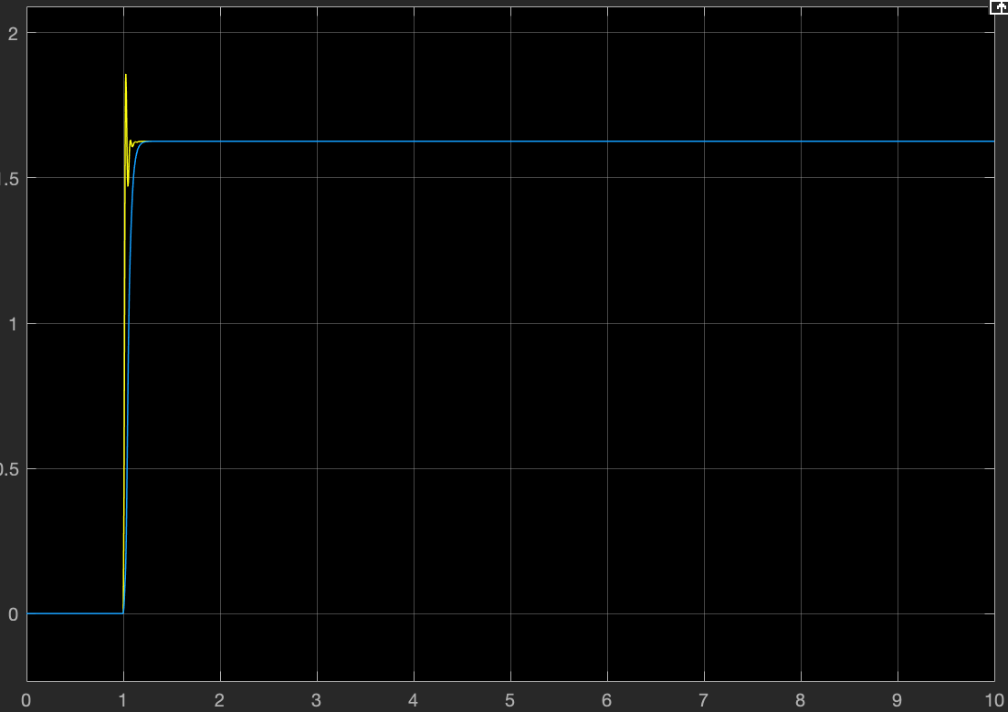
Dual Lead: Results
Controller output
Without actuator saturation
Dc(s) =
Works with +/- 25V actuator saturation limits
With actuator saturation
Simulink Simulation
System output
Without actuator saturation
Without actuator saturation
With actuator saturation
With actuator saturation

Slide 12
PID Compensator

Slide 13
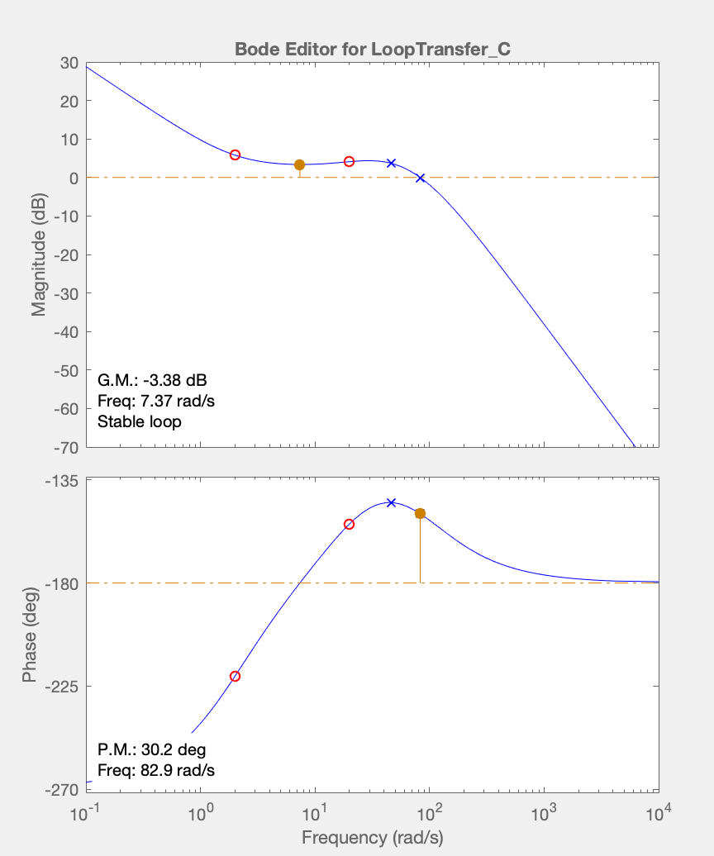
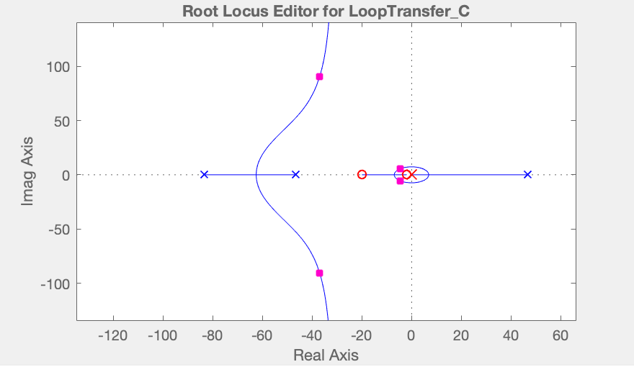
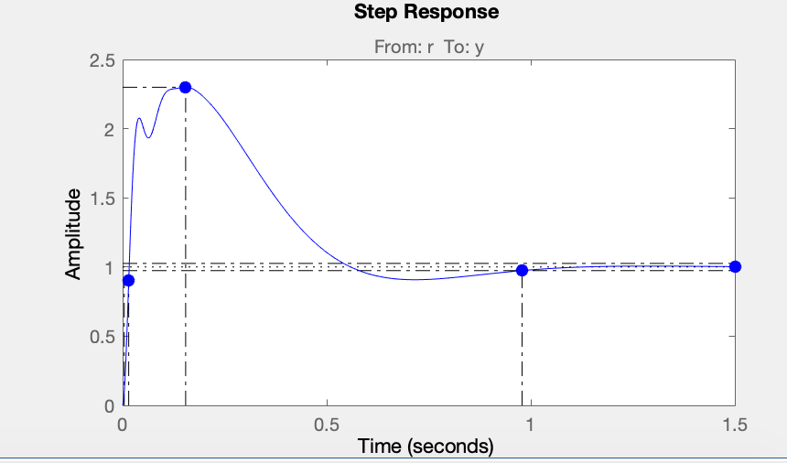
PID: Design
Dc(s) =
Specifications
Time
Fast rise time (0.019s)
High percent overshoot (130%)
Fairly fast settling time (0.979)
No steady state error
Frequency
Low but fair* GM (3.4 dB)
Fair PM (30.2 degrees)
Crossover frequency = 83 rad/s
Implementation
Compatible with actuator with +/- 32V range
*https://www.sciencedirect.com/science/article/pii/B9780128121382000027

Slide 14
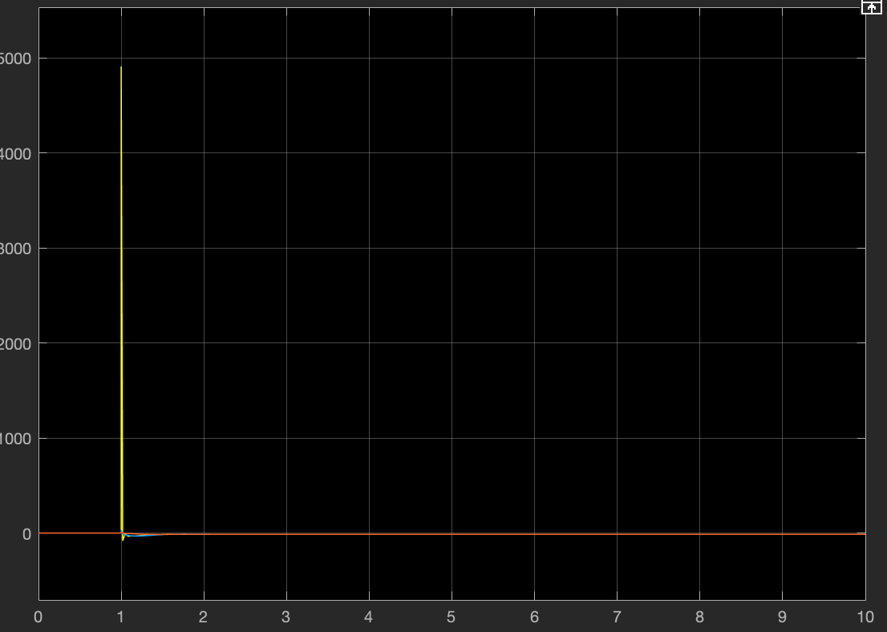
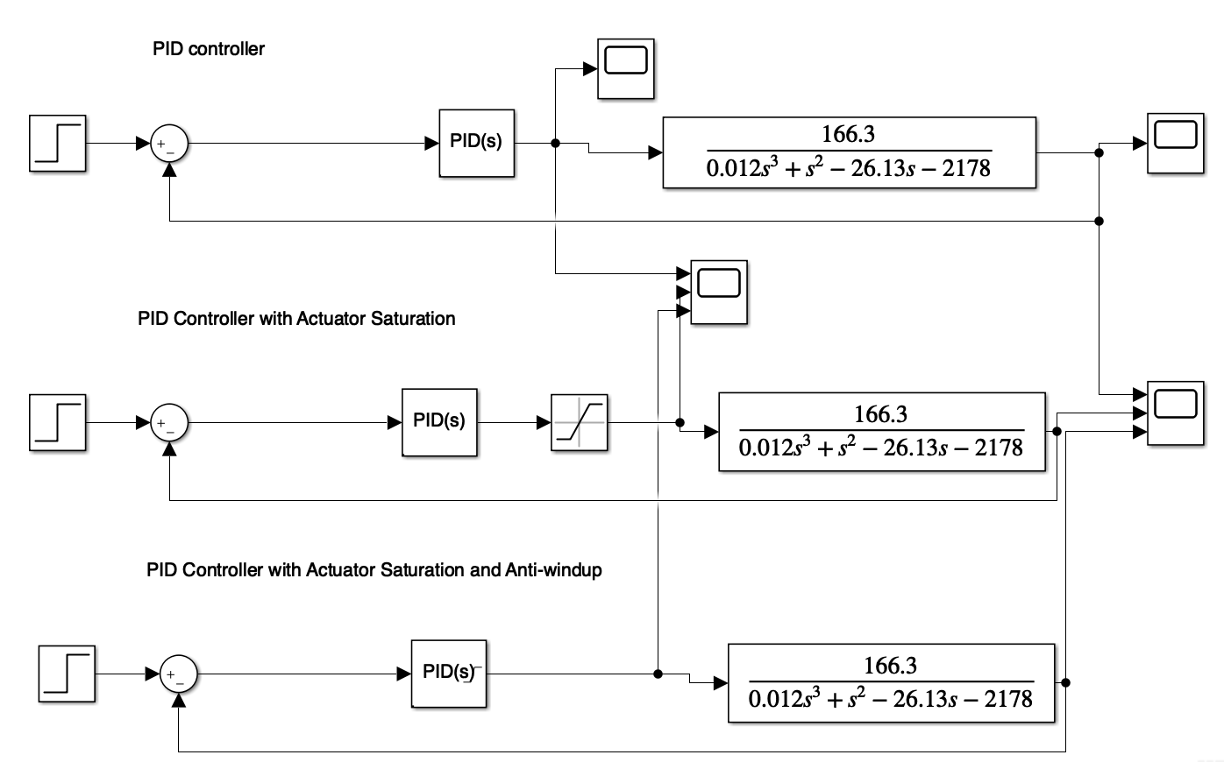
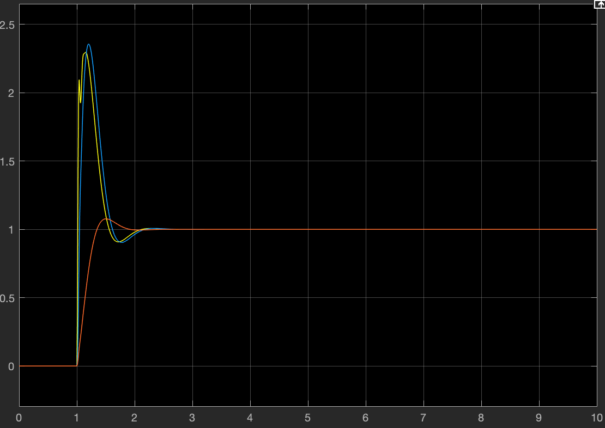
PID: Results
Controller output
Without actuator saturation
Dc(s) =
Without Anti-windup:
Works with +/- 32V actuator saturation
WIth Anti-windup
Works with +/- 15V actuator saturation
Lower overshoot
Simulink Simulation
With actuator saturation
With output saturation and anti-windup
System output
Without actuator saturation
PID(s) has Output Saturation +/- 15 and back-calculation anti-windup with Kb = 20
With actuator saturation
With output saturation and anti-windup
Notes:
Lower overshoot: Anti-windup compensator avoids the velocity overshoot by preventing the error buildup in the integral term

Slide 15
Conclusions
Comparison
Anti-windup PID and dual-lead most promising
Controller | GM (dB) | PM (degrees) | Actuator swing (V) | Final value
Lead | 1.79 | 13 | 75 | 5.36
Dual lead | 8.3 | 30 | 25 | 1.63
PID | 3.4 | 30.2 | 32 | 1
Anti-windup PID | 3.4 | 30.2 | 15 | 1

Slide 16
Sources
S. Pandey, A. Junghare, P. Dwivedi and N. K. Soni, "Experimental demonstration of anti-windup controller for non-linear magnetic levitation system," 2017 International Conference on Information, Communication, Instrumentation and Control (ICICIC), 2017, pp. 1-5, doi: 10.1109/ICOMICON.2017.8279085.
T. H. Wong, "Design of a Magnetic Levitation Control System: An Undergraduate Project," in IEEE Transactions on Education, vol. E-29, no. 4, pp. 196-200, Nov. 1986, doi: 10.1109/TE.1986.5570565.
A. Mohamed and M. Ibrahim, "Investigations on magnetic levitation using phase lead-lag controller," 2015 World Congress on Information Technology and Computer Applications (WCITCA), 2015, pp. 1-7, doi: 10.1109/WCITCA.2015.7367034.

Slide 17
Extras:
Analog Frequency
Compensator Implementation

Slide 18
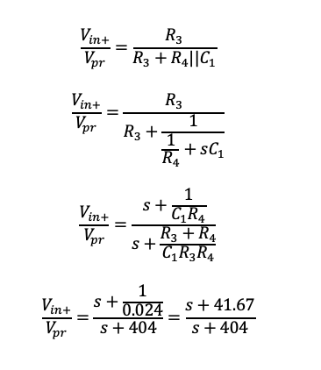
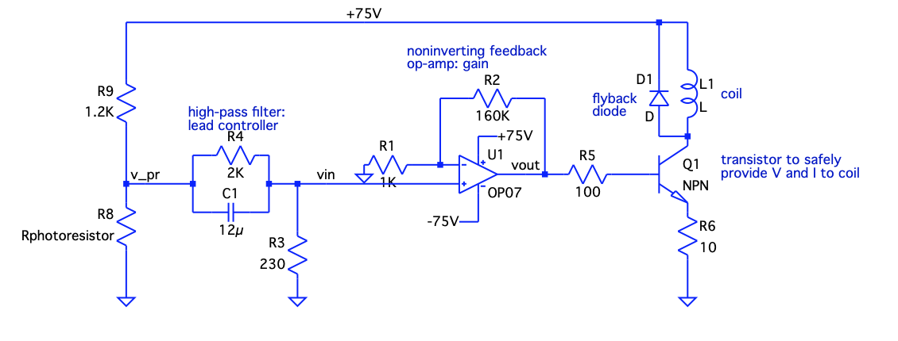
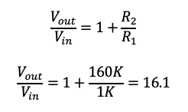
Single Lead
Dc(s) =
Analog Implementation
1 high pass filter and noninverting op-amp
Requires +/- 75V Op-Amp (not common, but exists)
High-Pass Filter
Non-inverting Op-Amp

Slide 19
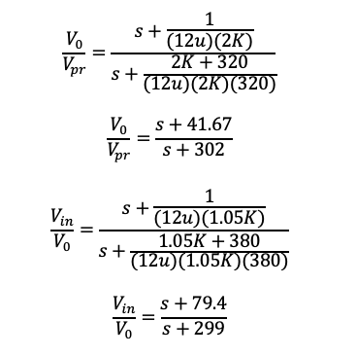
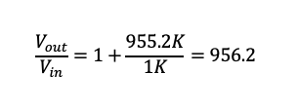
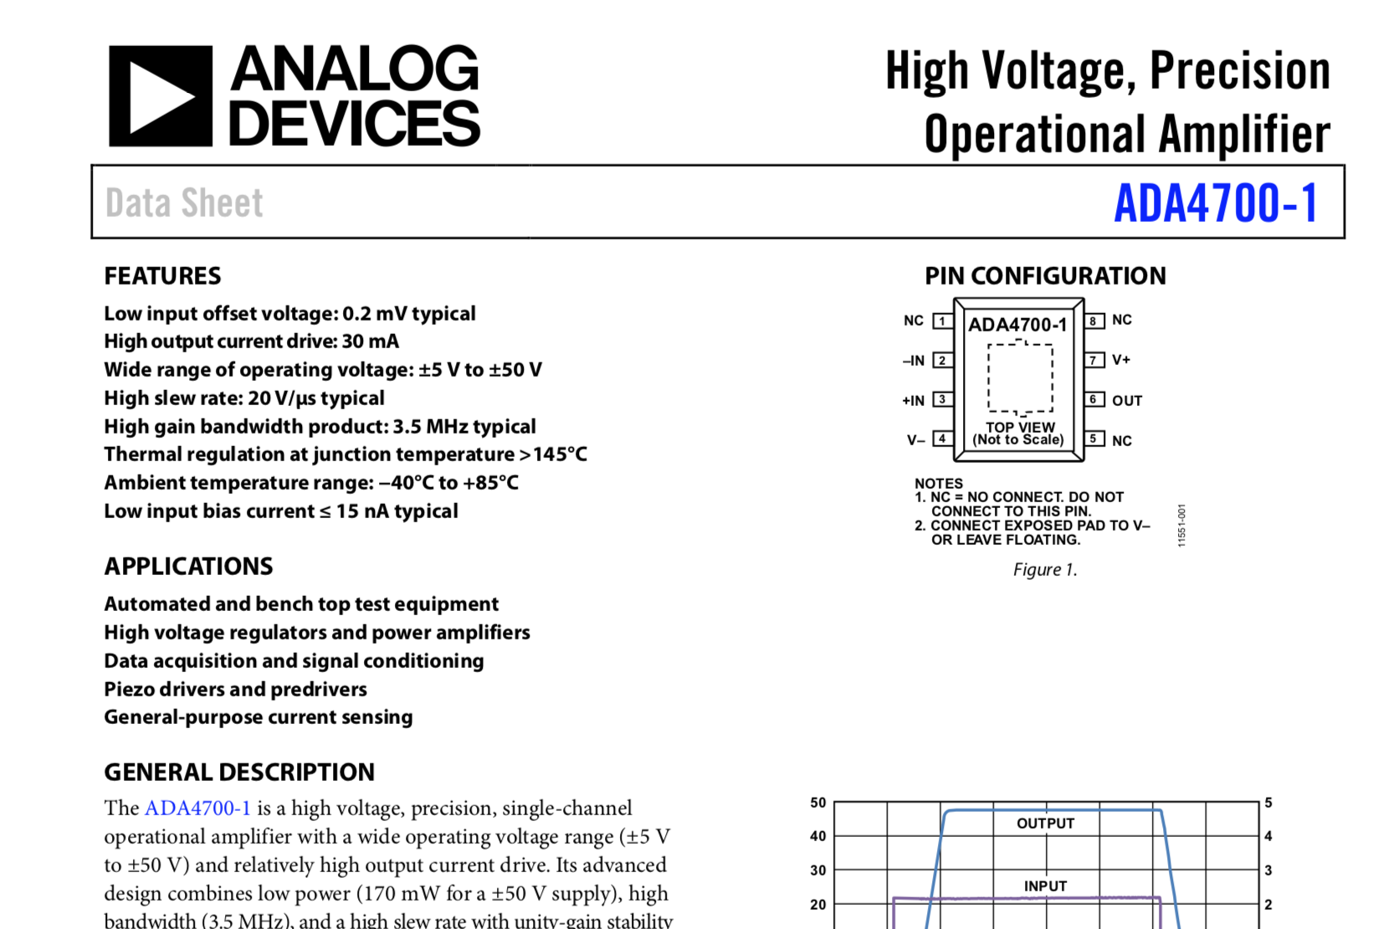
Dual Lead
High-Pass Filter
Non-inverting Op-Amp
Dc(s) =
Analog Implementation
2 high pass filters and noninverting op-amp
Requires +/- 25V Op-Amp (Common)

